Slide 1
PEAK Adventures Case For Support
Leadership | Adventure | Work

Slide 2
Vision & Mission
We envision a community with PEAK graduates discovering their God-given purpose, equipped for a life defined by hope and not by circumstance
Building leaders to break cycles of untapped potential, poverty and violence

Slide 3
PEAK Adventures History & Background
Founded in 2006 in Bryson City, NC, PEAK Adventure Ministries operated an adventure sports camp, teaching whitewater kayaking, wilderness trekking and caving to students in middle school and high school.
Relocating to Greensboro in 2009, PEAK Adventures shifted our focus to team building and leadership development programs based on experiential learning.
In 2014 we began using experiences and adventure to teach leadership to middle school students from high poverty backgrounds.
This led to our innovative “Leadership TEAM” model.
“I CAN LEAD MYSELF WELL” is our goal for all students.
In 2015 we launched the Summer Work Project with three students.
In 2017 we recast PEAK Adventures as a community impact ministry in Greensboro. We believed we could effect positive change by leveraging our strengths in youth leadership and adventure learning.
In 2019 we expanded into High Point.
In 2021 PEAK Adventures begins our Program Outcome Measurements and Capacity Building Phase for the next five years.

Slide 4
PEAK Adventures Why We Focus On Communities
Guilford County faces twin crises of poverty and violence
22% of school age children grow up in poverty in Guilford County
Greensboro and High Point are in the “Top 40” deadliest cities in the US
The Social Costs Are Enormous
The Cone Health System provided $425M in uncompensated (charity) care in 2018
Over 40% of all Guilford County students are scored “not proficient” in math and language arts
North Carolina spends $37K per year to incarcerate a man

Slide 5
PEAK Adventures Where We Are Strong
We focus on leadership development for underserved populations
We serve students from neighborhoods experiencing high rates of poverty and violence
We collaborate with schools, churches and community organizations
Our programs stress self-leadership skills
Self-Control
Self-Discipline
Self-Respect
Our goal for ALL students: I CAN LEAD MYSELF WELL
Our programs meet the unique needs of this population
Highly relational, centered on a small group
Hands on, experiential learning
Outdoor adventures

Slide 6
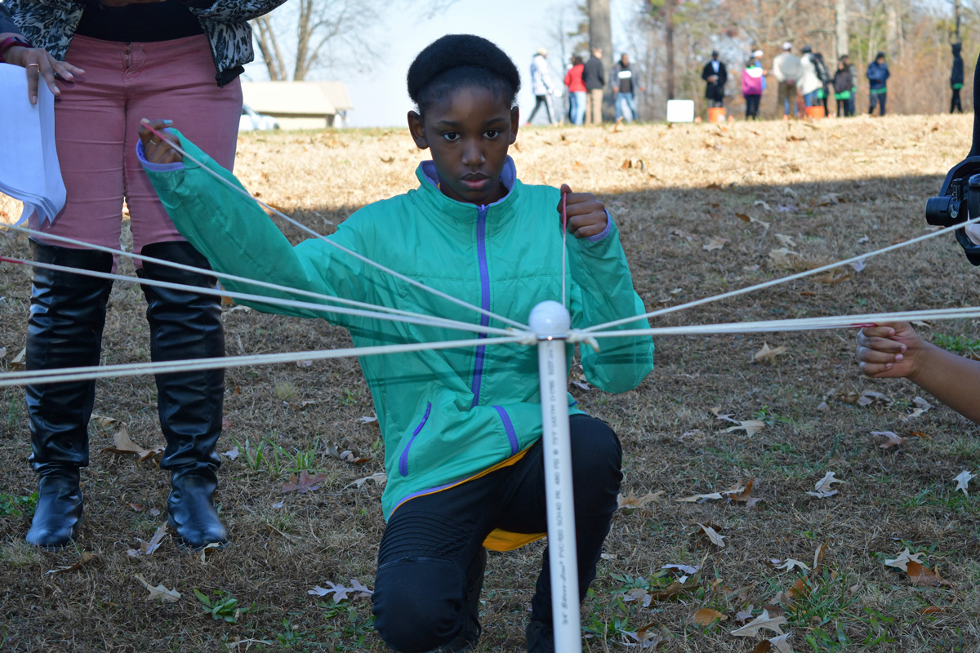
PEAK Adventures Where We Are Strong

Slide 7
PEAK Adventures Where We Are Unique
We track success through clear measurements
Academics / Attendance / Attitude
Our programs are progressive
7th & 8th grades: focus on leadership skills
9th & 10th grades: Right Start Mentoring
11th & 12th grades: Next Step Mentoring
High school students participate in the Summer Work Project
Our teen employment program has a 7-year track record of success
Students earn money while serving in their communities
We address the needs of the whole person
Academic / Physical / Spiritual / Social

Slide 8
PEAK Adventures How We Impact Communities
We invest in students for long term returns
Our programs are progressive, 7th grade through 12th grade
Students are coached to become leaders, starting with themselves
We focus where the needs are greatest
We target middle schools that draw their students from neighborhoods experiencing high poverty and violence
Hairston Middle, Jackson Middle and Welborn Middle
Relationships are the cornerstone of our programs
Our 1:1 interactions develop deep connections
We extend the relationships to parents, the school and the community
We meet needs in the community through our Summer Work Program
Our “Widows Brigade” serves widowed, elderly and disabled residents

Slide 9
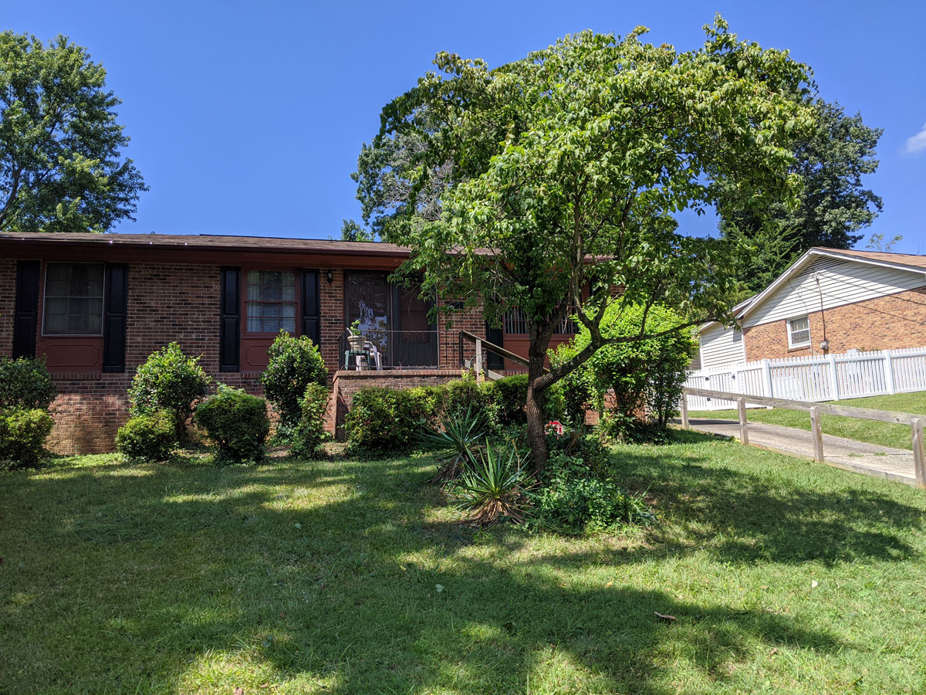
PEAK Adventures How We Impact Communities
Summer Work Project
Before
After

Slide 10
PEAK Adventures
Community Impact Ministry Model
9th – 12th Grades
Summer Work Project
7th Grade
8th Grade
Leadership TEAM
Leadership
LIFE
9th & 10th
Grades
11th & 12th
Grades
Right Start Mentoring
Next Step Mentoring

Slide 11
PEAK Adventures
Targeted Investing Yields Results
Our Challenge | PEAK’s Solution | Our Results
Students raised in poverty underperform their more advantaged peers by every measure | We challenge middle schoolers to focus on the “3 A’s”: Academics Attendance Attitude | For high-risk youth, the ROI is $2.72 per dollar spent in quality youth programs. Since 2014, 100% of PEAK students either graduated high school or currently attend high school. None entered the criminal justice system.
The unemployment rate for Black male teens was over 50% in 3Q 2019 (pre COVID) | The Summer Work Project provides discipline, structure and fosters a “success through effort” mindset. | In 2020, PEAK Adventures paid over $10,500 in wages to students growing up in high poverty neighborhoods
A lack of marketable skills contributes to substance abuse and criminal activity in young adults | Right Start mentoring focuses on building a strong academic foundation in 9th and 10th grades. Next Step mentoring will focus on a written plan for life after high school | We launched Right Start in 9/20 to meet the needs of students struggling with on-line only education. We expect significant returns from this program.

Slide 12
PEAK Adventures Why Invest In Our Organization
Our middle school programs work
We have 6 years experience teaching leadership development to students from high poverty neighborhoods
We have a successful track record
Over six years PEAK Adventures has paid over $26k in wages to students enrolled in our Summer Work Project
Our model can scale
With sufficient resources we can serve more middle schools, run a larger Summer Work Project and mentor more high school students
Our model can be replicated
We can teach and coach other organizations to launch their own high impact youth programs
We have a vision
500 middle school students leaning “I CAN LEAD MYSELF WELL” each year
100 students employed each summer
80 students mentored through their high school years

Slide 13
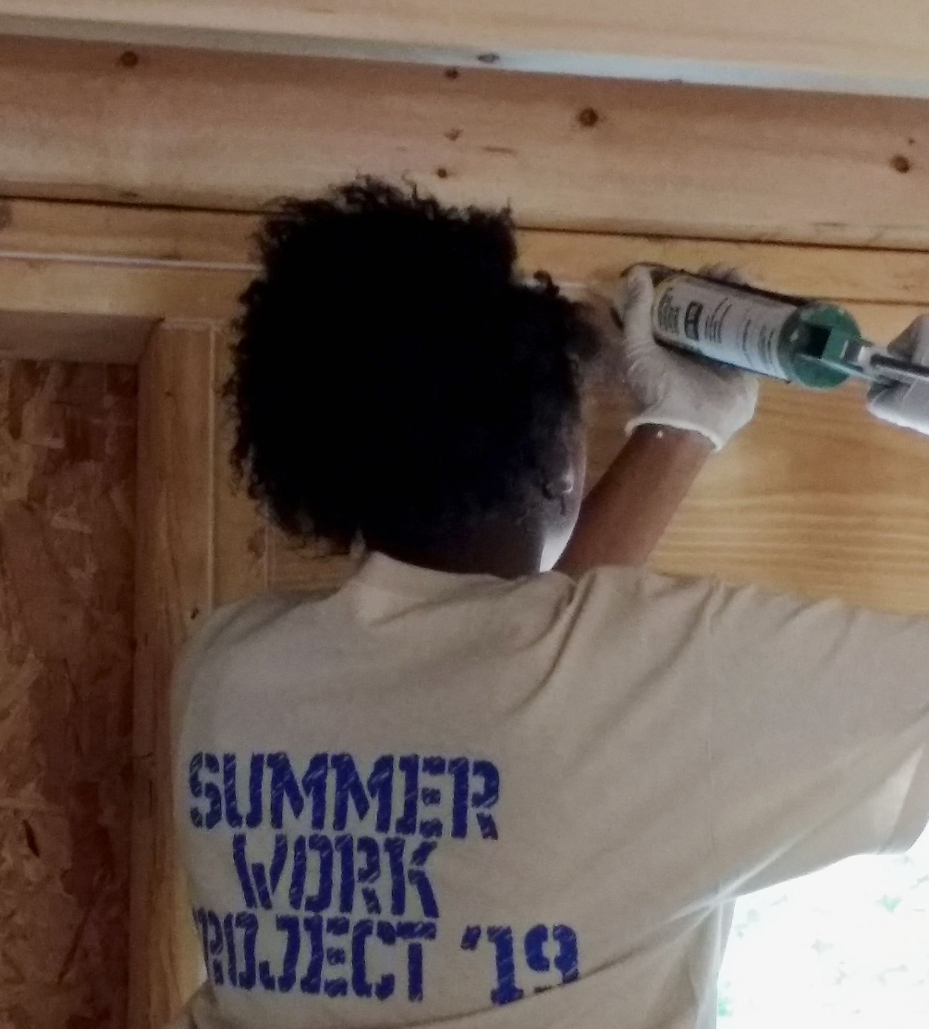
PEAK Adventures 6 Years of Impact
2000+ Participants Served
Through leadership development and team building programs
3000+ Hours Worked
By students in the Summer Work Project
$26,000+ In Wages Paid with SWP
To students ages 14 to 18
40 Students Served Each Week
Through our middle school leadership programs

